Slide 1
Fuel Cells
A fuel cell is a device that generates electricity through an electrochemical reaction, not combustion.
In a fuel cell, hydrogen and oxygen are combined to generate electricity, heat, and water.
A fuel cell is similar to electrochemical cells, which consists of a cathode, an anode, and an electrolyte. In these cells, the electrolyte enables the movement of the protons.
The first fuel cells were invented by Sir William Grove in 1838.
A typical cell produces 0.6V to 0.7V

Slide 2
Fuel Cells – Working Principle
A fuel cell is composed of an anode, cathode, and an electrolyte membrane.
A fuel cell works by passing hydrogen through the anode of a fuel cell and oxygen through the cathode.
At the anode site, a catalyst splits the hydrogen molecules into electrons and protons.
The protons pass through the porous electrolyte membrane, while the electrons are forced through a circuit, generating an electric current and excess heat.
At the cathode, the protons, electrons, and oxygen combine to produce water molecules.
As there are no moving parts, fuel cells operate silently and with extremely high reliability.

Slide 3
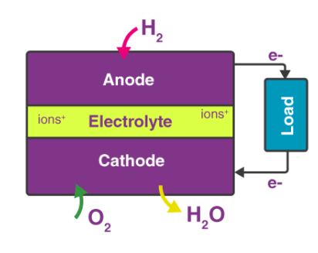
Components of fuel cell
Anode
The anode, the negative post of the fuel cell conducts the electrons that are freed from the hydrogen molecules so that they can be used in an external circuit.
Cathode
The cathode, the positive post has channels etched into it that distribute the oxygen to the surface of the catalyst.
Electrolyte
The electrolyte enables the movement of the protons
Catalyst
The catalyst is a special material that facilitates the reaction of oxygen and hydrogen. (Platinum, Palladium etc.,)

Slide 4
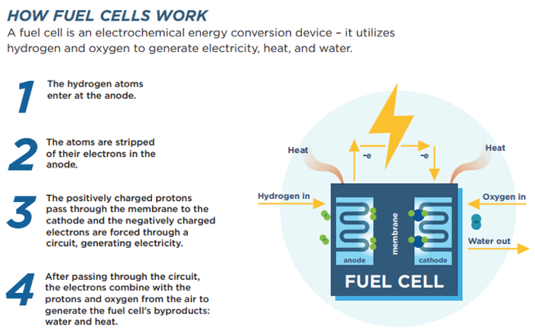
Cathode Reaction: O₂ + 2H₂O + 4e– → 4OH–
Anode Reaction: 2H₂ + 4OH– → 4H₂O + 4e–
Net Cell Reaction: 2H₂ + O₂ → 2H₂O

Slide 5
Advantages of Fuel Cell
Disadvantages of fuel cell
Environmental Friendly
High Efficiency
Versatility in Fuel Sources (Hydrogen, ethanol, natural gas etc.)
Distributed Generation (can be installed at or near the point of use)
Quiet Operation
Cogeneration Capabilities
Long Duration and Continuous Operation
Scalability (various power requirements)
Reduced Dependency on Fossil Fuels
Cost
Hydrogen infrastructure
Fuel Availability and Storage
Durability and Lifespan
Sensitivity to Contaminants
Limited Operating Temperature Range
Limited Power Density

Slide 6
Battery cell | Fuel cell
They store energy in the form of chemical energy | They cannot store energy. Fuel cell converts chemical energy to electrical energy.
Reactants are inside the cell itself. | Reactants for chemical reaction are supplied continuously.
Chemical reaction products remain inside the cell itself | Chemical reaction products are removed from the cell
Rechargeable | Not rechargeable
Less efficiency | High efficiency
It consists of limited amount of fuel and oxidant and these reactants diminish with time | Needs a continuous supply of fuel and oxygen from an external source
Supply energy for a limited period of time | Supply energy for a long period of time
Less expensive | They are expensive
Example : lithium ion batteries | Example : hydrogen-oxygen fuel cell

Slide 7
Electronic and ionic conductivity of fuel cells
Electronic Conduction
Electronic conduction is the process of transferring energy in the form of an electric current.
However, any electron in any system cannot contribute to this conduction method.
Electrons have to be in a free state in order to move from one place to another.
Ionic Conduction
Ionic conduction is the process of transferring energy via the movement of ionic species.
During ionic conduction, different ionic species move from one place to another place according to an ionic gradient.
An ion is a charged species; it can be either positively charged or negatively charged.

Slide 8
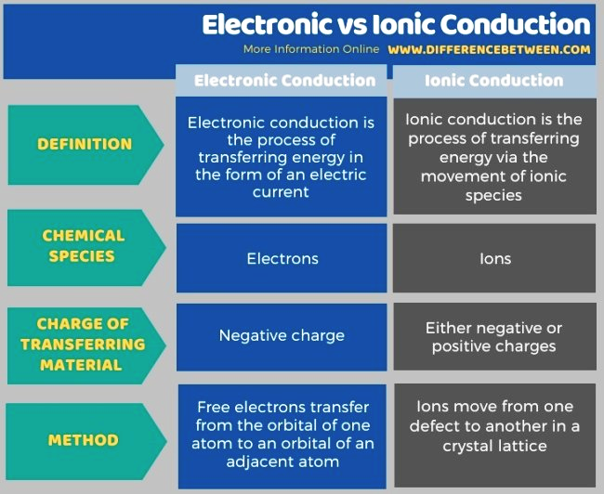

Slide 9
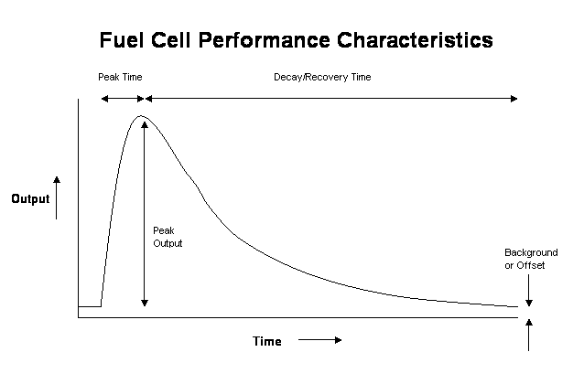
Peak Output – The maximum voltage or current generated from the cell after a sample has been introduced.
Peak Time – The time taken to reach the Peak Output above.
Background/offset – The steady state voltage or current output from the cell prior to introduction of the sample.
Decay/clearing Time – The time taken for the cell to return to the steady state offset.
Repeatability – The precision of the Peak Output achieved from successive identical samples.
Calibration Stability – The precision of the Peak Output achieved with samples taken over a long period of time.
Linearity – The correlation precision of the Peak Output at increasing gas concentrations.

Slide 10
Types of fuel cells
Polymer Electrolyte Membrane (PEM) Fuel Cell
Phosphoric Acid Fuel Cell
Solid Oxide Fuel Cell
Alkaline Fuel Cell
Molten Carbonate Fuel Cell

Slide 11
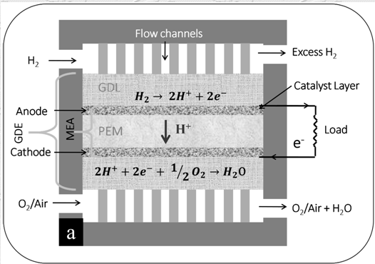
Polymer Electrolyte Membrane (PEM) Fuel Cell

Slide 12
PEM Fuel Cell
Polymer electrolyte membrane fuel cells (PEMFCs) are low operating temperature fuel cells (FCs) consisting of a polymer membrane as electrolyte.
As the polymer membranes conduct H⁺ ions, PEMFCs are also termed as proton exchange membrane FCs.
They use hydrogen or low molecular weight hydrocarbons as the fuel at anode and oxygen/air as the oxidizer at cathode.
In a PEMFC, hydrogen is oxidized at anode to produce H⁺ ions, which migrate through the PEM to the cathode.
Reduction of oxygen takes place at cathode to form O²⁻ ions, which combine with the H⁺ ions to form H₂O.
This develops a net cell potential that equals to the difference between electrochemical potentials of hydrogen oxidation reaction (HOR) and oxygen reduction reaction (ORR).
When connected to an external load, a constant current can be drawn if the reactant gases are supplied and the reaction product (H₂O) is removed continuously to maintain the system in steady state.

Slide 13
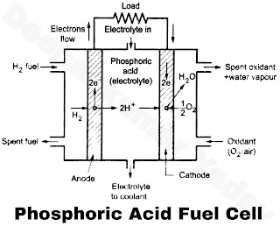
Phosphoric Acid Fuel Cell
It was developed in 1980s.
It uses either pure hydrogen or rich hydrogen gas as fuel and oxygen or air as oxidant.
The concentrated phosphoric acid (H₃PO₄) is used as electrolyte.
It has two electrodes of porous conducting material, usually of nickel material to collect charge.
The electrochemical reaction is normally very slow, therefore a catalyst is needed in the electrodes to accelerate the reaction.
Finely powdered nickel/platinum/silver coating is provided on the outer surface of electrodes which act as catalyst.
The operating temperatures for this type of fuel are in the range of 150°C-220°C.
Anode : H₂ → 2 H⁺ + 2e ...(v)
Cathode : 1/2 O₂ + 2H⁺ + 2e → 2OH⁻ ...(vi)
Overall reaction : H₂ + 1/2 O₂ → H₂O + heat + power

Slide 14
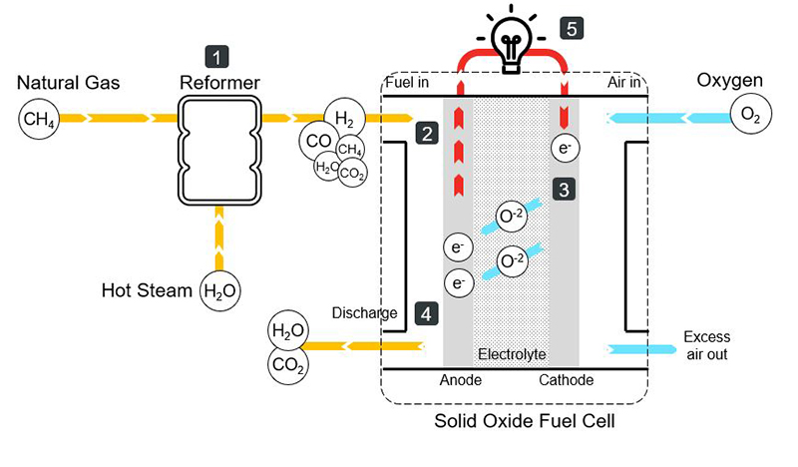
Solid Acid Fuel Cell
Natural gas goes through a steam-reforming process.
This chemical reaction produces hydrogen (H₂), carbon monoxide (CO), carbon dioxide (CO₂) and steam (H₂O).
The mix of elements from the reformer enter the fuel cell at the anode side.
Meanwhile, air (including oxygen) enters the fuel cell at the cathode side.
Oxygen in the air combines with free electrons to form oxide ions at the cathode.
Oxide ions with free electrons travel from the cathode to the anode through the electrolyte.
At the anode, oxide ions react with hydrogen forming water (steam) and with carbon monoxide (CO) forming carbon dioxide (CO₂).
These free electrons travel to cathode through the external electrical circuit, producing electricity.

Slide 15
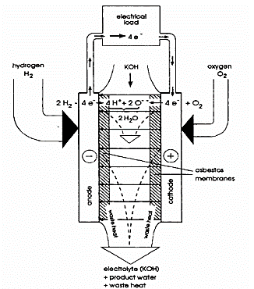
Alkaline Fuel Cell (AFC)
The AFCs utilize potassium hydroxide (KOH) as an electrolyte of variable concentration, either in aqueous solution or stabilized matrix form.
The electrolyte is contained in a porous asbestos matrix, and the catalysts are typically made of nickel (Ni) and silver (Ag).
Hydrogen and oxygen are supplied to the electrodes similarly to PEMFCs.
The KOH electrolyte is extremely sensitive to potential poisoning with CO or reaction with CO₂ and, thus, only pure hydrogen and oxygen can be used as reactants for the electrochemical processes.
The carrier in this case is the hydroxyl ion (OH– ), which travels from the cathode to the anode, where it combines with H2 and creates water and electrons.
The basic electrochemical reactions for the AFC are:
Anode: 2 H₂ + 4 OH¯ → 4 H₂O + 4 e−
Cathode: O₂ + 2 H₂O + 4 e− → 4 OH¯
Cell reaction: 2H₂ + O₂ → 2 H₂O

Slide 16
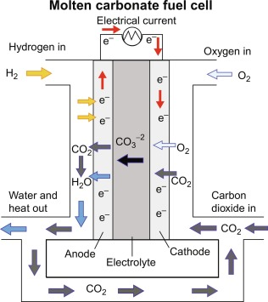

Molten Carbonate Fuel Cell (MCFC)
MCFCs are fuel cells that operate at high temperatures using an electrolyte composed of a molten carbonate salt mixture suspended in a porous, chemically inert ceramic lithium aluminum oxide.
When heated to 650°C, the electrolytes in MCFCs melt and conduct carbonate ions from the cathode to the anode
At the anode, hydrogen combines with carbonate ions, producing water and carbon dioxide and releasing electrons to the external circuit.
At the cathode, oxygen is reduced by carbon dioxide and electrons to carbonate ions.

Slide 17
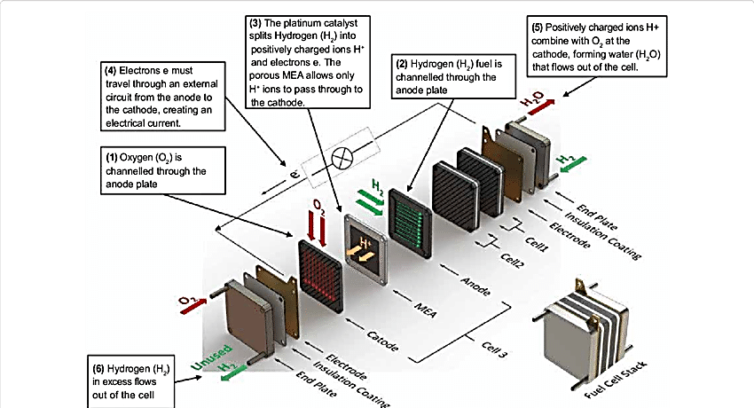
Fuel Cell Stack

Slide 18
Fuel Cell Stack
The fuel cell stack is the heart of a fuel cell power system.
It generates electricity in the form of direct current (DC) from electrochemical reactions that take place in the fuel cell.
A single fuel cell produces less than 1 V, which is insufficient for most applications.
Therefore, individual fuel cells are typically combined in series into a fuel cell stack.
A typical fuel cell stack may consist of hundreds of fuel cells.
The amount of power produced by a fuel cell depends upon several factors, such as fuel cell type, cell size, the temperature at which it operates, and the pressure of the gases supplied to the cell.

Slide 19
Criteria for selection of fuel cells
Combined Heat and Power (CHP)
Production cost
Estimation cost
Pollution
Energy supply limits
Stack size
Efficiency
Working temperature

Slide 20
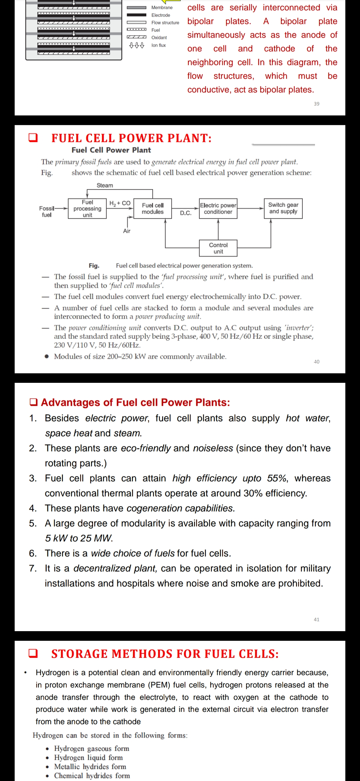
Fuel Cell Power Plant

Slide 21
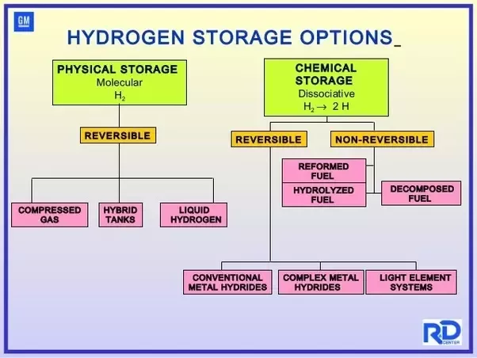
Storage methods of Hydrogen
Hydrogen is difficult to store due to its low volumetric energy density.
It is the lightest of and simplest of all elements, being lighter than helium, and so is easily lost into the atmosphere.
Hydrogen can be stored in three different ways:
As a gas under high pressures
In liquid form under cryogenic temperatures
On the surface of or within solid and liquid materials.

Slide 22
Physical storage methods of Hydrogen
Compressed Gas
Hydrogen can be compressed and stored in a gaseous form under high pressures. This requires storage tanks to have pressures of 350-700 bar or 5000-10,000 psi.
Cryogenic Liquid Storage
Hydrogen can be stored cryogenically in a liquid form.
Low temperatures are required to stop the liquid hydrogen from boiling off back into a gas, which occurs at -252.8°C.
Liquid hydrogen has a higher energy density than gaseous hydrogen but getting it down to the required temperatures can be costly.
Combined Cold-and-Cryo-Compressed Hydrogen
The storage methods of compression and cryogenic cooling used above can also be combined to create a further development of hydrogen storage.
In this instance, the hydrogen is cooled before being compressed.
This creates a higher energy density than with compressed hydrogen but, as with cryogenic liquid storage, also requires more energy use to achieve.

Slide 23
Chemical storage methods of Hydrogen
Underground Hydrogen Storage
Salt caverns, exhausted oil and gas fields or aquifers can all provide underground hydrogen storage on an industrial scale
Metal Hydrides:
Some metals have a special ability to "soak up" hydrogen like a sponge.
These metals create compounds called metal hydrides, which hold onto the hydrogen.
When needed, the hydrogen can be released from these compounds.
Chemical Hydrides:
Certain chemical compounds, known as hydrides, can also store hydrogen.
These compounds chemically bind with hydrogen, keeping it inside.
To release the hydrogen, we can use heat or catalysts to break the chemical bonds.
Carbon-based Materials:
Hydrogen can also be stored in materials made of carbon, like activated carbon or carbon nanotubes.
These materials have tiny spaces where hydrogen molecules can stick, like a sponge absorbs water.
By adsorbing hydrogen, these materials can hold onto it until it's needed.

Slide 24
Challenges in Fuel cell
Cost.
The cost of fuel cell power systems must be reduced before they can be competitive with conventional technologies.
Durability and Reliability.
The durability of fuel cell systems has not been established. For transportation applications, fuel cell power systems will be required to achieve the same level of durability and reliability of current automotive engines.
System Size.
The size and weight of current fuel cell systems must be further reduced to meet the packaging requirements for automobiles.
Air, Thermal, and Water Management.
Air management for fuel cell systems is a challenge because today's compressor technologies are not suitable for automotive fuel cell applications.
Improved Heat Recovery Systems.
The low operating temperature of PEM fuel cells limits the amount of heat that can be effectively utilized in combined heat and power (CHP) applications. Technologies need to be developed that will allow higher operating temperatures and/or more effective heat recovery systems

Slide 25
Advantages of Fuel Cells
Efficiency – Fuel cells are highly efficient, which means they convert fuel into electricity with very little waste. This is because fuel cells operate at much higher temperatures than traditional power plants, which allows them to extract more energy from the fuel.
Clean Energy – Fuel cells produce electricity through a chemical reaction between hydrogen and oxygen, which means they emit only water and heat as byproducts. This makes them a clean source of energy that doesn’t produce harmful pollutants like traditional power plants.
Versatility – Fuel cells can be used in a variety of applications, from powering small electronics to generating electricity for large buildings or even entire cities. They can also be used in transportation, such as powering buses or cars.
Reliability – Fuel cells are highly reliable because they have no moving parts, which means there is less chance of mechanical failure. This makes them a great choice for applications where downtime is not acceptable.
Longevity – Fuel cells have a long lifespan and require little maintenance, which means they can last for many years with minimal upkeep. This makes them a cost-effective option for producing electricity over the long-term.

Slide 26
Disadvantages of Fuel Cells
Cost – Fuel cells can be expensive to manufacture and install, which can make them a less attractive option for some applications. Additionally, the cost of hydrogen fuel can be higher than other types of fuel, which can also impact their overall cost-effectiveness.
Infrastructure – Fuel cells require a dedicated infrastructure for the storage and distribution of hydrogen fuel, which can be a challenge to establish and maintain. This can limit their use in certain areas or make them less practical for some applications.
Efficiency – While fuel cells are highly efficient, they still require energy to produce hydrogen fuel. This means that they may not be as efficient as other forms of energy production that use renewable sources like solar or wind power.
Durability – Fuel cells are made up of delicate components that can be damaged by extreme temperatures, vibration, or other factors. This means that they may require more maintenance and have a shorter lifespan than other types of energy production.
Safety – Hydrogen fuel is highly flammable and requires careful handling to ensure safe storage and use. This can be a concern in certain applications, such as transportation or in areas with high population density.

Slide 27
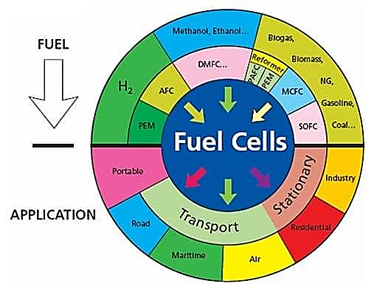
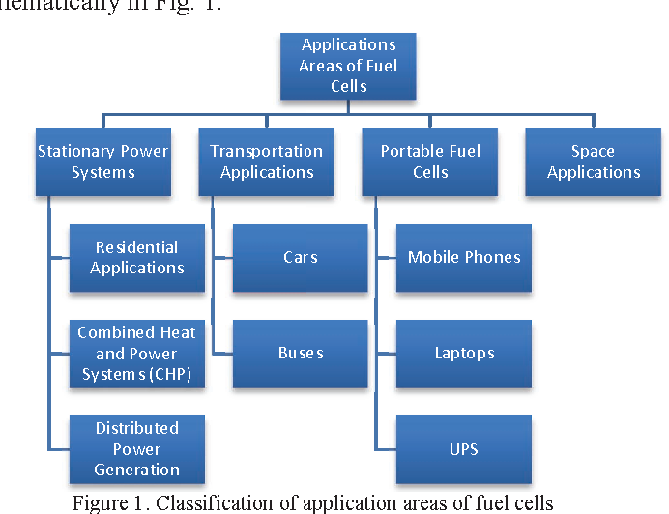
Applications of fuel cells

Slide 28
CHALLENGES AND TRENDS IN FUEL CELL:
• A Fuel Cell Power Source (FCPS) has emerged as a relatively efficient
and clean option for power generation because of its high efficiency and
low emissions. Significant progress has been made in optimization of
Fuel Cells for their use in portable, stationary and vehicular applications.
• The fuel cell (FC) technology became in focus within the hydrogen
energy landscape as a cost-effective pathway to utilize hydrogen for
power generation. Therefore, FC technologies’ research and
development (R&D) expanded into many pathways such as cost
reduction, efficiency improvement, fixed and mobile applications,
lifetime, safety and regulations, etc.
• Being an emerging technology, Fuel Cell (FC) Power Source (FCPS)
incurs higher investments on development and involves high operating
cost. Therefore, to get the best returns on the investment, it is
necessary that the FCPS is utilized optimally under all operating
conditions.

